Slide 1

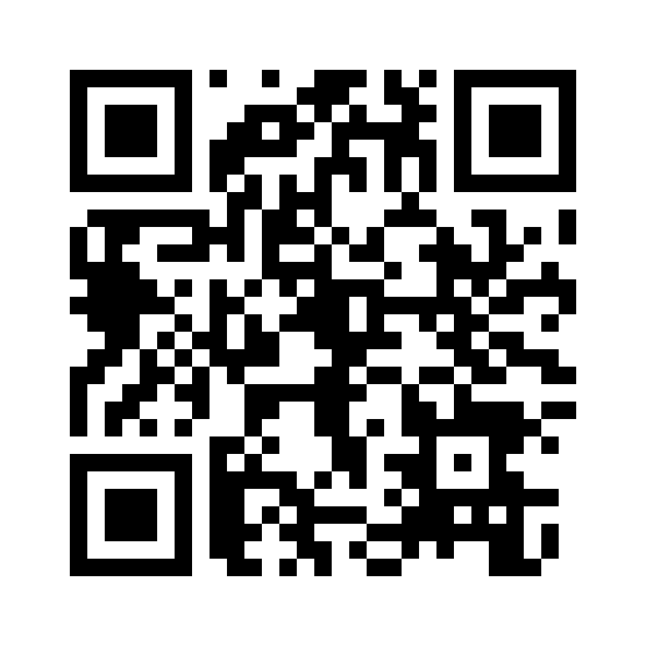



Azure Solutions Architect – Data and Storage
Scan this QR-code to access free resources, step-by-step learning guides as well as get practical experience in Azure Architecture – Data and Storage!
https://aka.ms/AA90uvt
Don’t forget to add Microsoft Azure as a skill to your LinkedIn account to stay connected with a developer community!
+ Microsoft Azure
We post the latest announcements about free events for developers in Ireland on our official Twitter account!
@MSDevIRL

Slide 2
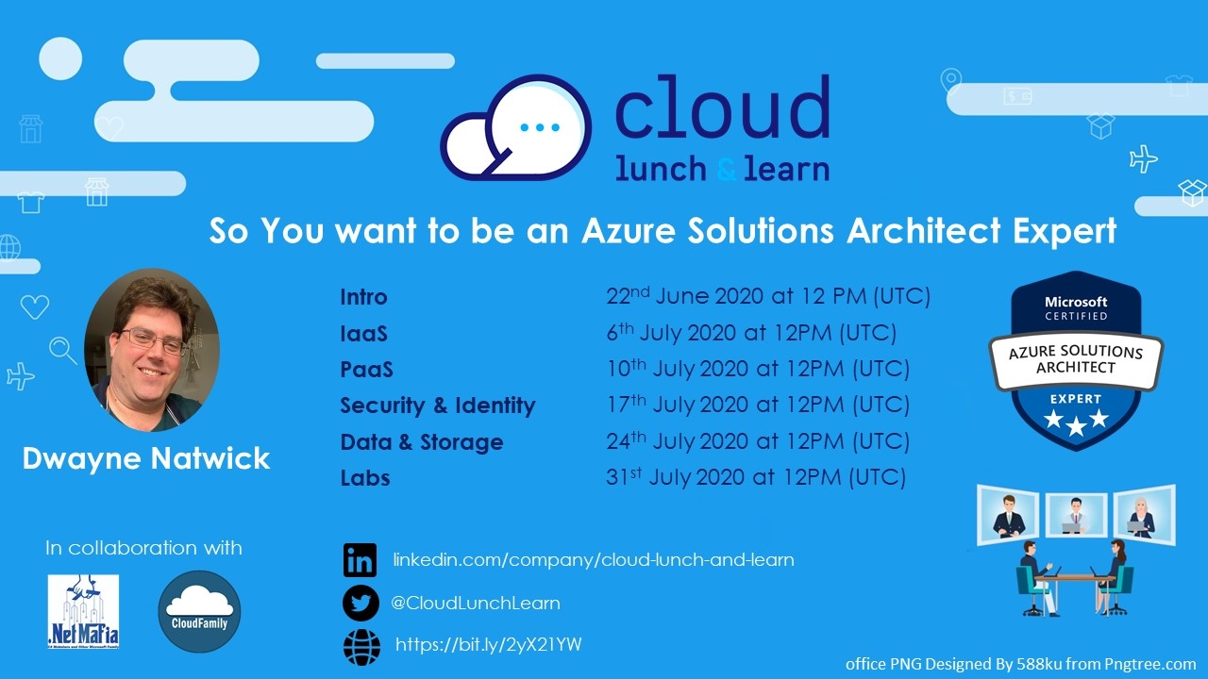

Slide 3
SO YOU WANT TO BE AN AZURE ARCHITECT EXPERT
Data and Storage objectives
Notes:
Thank you for joining this Cloud lunch and learn session. I’m going to speak to you today about Azure Certifications and Becoming a certified Azure Developer Associate

Slide 4




ABOUT THE AUTHOR
I am an author, trainer, and product manager with over 30 years of experience in the IT industry. I am a CISSP, PMP, and certified in multiple Azure and M365 roles, including Solution Architect Expert, Administrator Associate, and Security Engineer Associate.
In addition to creating curriculum, training, public speaking, and blog writing, I am also a Microsoft Certified Trainer and Regional Lead.
You can find me on social media at:
https://captainhyperscaler.com
http://linkedin.com/in/dnatwick
@DwayneNcloud
Dwayne Natwick
Sr. Cloud Training Architect
CISSP, PMP, 9x Azure/M365 Certified
MCT Regional Lead
Notes:
My name is Dwayne Natwick and I will be your instructor for this course. I am an author, trainer, and product manager that has been in the IT industry for over 30 years. I currently have multiple Azure and 365 role-based certifications along with my CISSP and PMP.​
​
I am a Microsoft Certified Trainer and a Regional Lead for the program. You can find me active on social media at the links provided on the slide.​

Slide 5

AZURE SOLUTIONS ARCHITECT EXPERT OBJECTIVES AND KEY AREAS
Azure Solutions Architect Expert certification objectives were adjusted earlier this year
Exam numbers will be changing
  AZ-300 retires on September 30, 2020, replaced by AZ-303 (beta June 29)
  AZ-301 retires on September 30, 2020, replaced by AZ-304 (beta June 29)
Passing both exams will award you with the Azure Solution Architect Expert certification (good for two years)
Objective areas by exam
  AZ-300/AZ-303: https://query.prod.cms.rt.microsoft.com/cms/api/am/binary/RE3VzwB
  AZ-301/AZ-304: https://query.prod.cms.rt.microsoft.com/cms/api/am/binary/RE3VEHD
Notes:
Let’s move into the specifics of the Azure Developer Associate exam.
The objectives to this exam were adjusted and updated earlier this year and this has led to Microsoft changing the exam number from AZ-203 to AZ-204. Both of these exams are currently active and you will obtain the Azure Developer Associate certification. The 203 exam will retire on August 31 of this year, and then the 204 will be the one an only exam for this certification.
Associate and Expert exams are valid for two years.
The objectives covered on this exam are listed here and will be covered in the next few slides.

Slide 6
MICROSOFT AZURE ARCHITECT TECHNOLOGIES (300/303 EXAM)
Objective areas:
  Deploy and configure infrastructure (40-45%)
  Implement workloads and security (25-30%)
  Create and deploy apps (5-10%)
  Implement authentication and secure data (5-10%)
  Develop for the cloud and for Azure storage (15-20%)
Very closely aligned to the AZ-104 exam
Long exam, one of the few that could take up the entire time
Notes:
Connect to and consume Azure services and third party services is the next objective. Like the previous objective, you can expect around 15 questions on these objective areas.
If you add the weighted percentages of these first two objective areas, you can see that these make up 50-60% of the exam.
The key areas to be sure to understand here is how to configure and setup Azure Logic Apps, Azure Event Grid, Azure Notification hubs, Azure Event Hubs, Azure Services bus, and Azure Storage Queues. As well as API management for third party services.

Slide 7
MICROSOFT AZURE ARCHITECT DESIGN (301/304 EXAM)
Objective areas:
  Determine workload requirements (10-15%)
  Design for identity and security (25-30%)
  Design a data platform solution (15-20%)
  Design a business continuity strategy (15-20%)
  Design for deployment, migration, and integration (10-15%)
  Design an infrastructure strategy (15-20%)
More design focus with case studies
Databases
Azure Site Recovery
Azure Migrate
Notes:
Connect to and consume Azure services and third party services is the next objective. Like the previous objective, you can expect around 15 questions on these objective areas.
If you add the weighted percentages of these first two objective areas, you can see that these make up 50-60% of the exam.
The key areas to be sure to understand here is how to configure and setup Azure Logic Apps, Azure Event Grid, Azure Notification hubs, Azure Event Hubs, Azure Services bus, and Azure Storage Queues. As well as API management for third party services.

Slide 8
DATA AND STORAGE TOPICS
Data evolution
Azure Storage
Relational and Non-Relational Databases
Big Data Options
Choosing an option
Notes:
This discussion is going to provide you with guidance on determining a certification path and building your certification roadmap, preparing for an exam, including some learning resources to use in your preparation.
We will then go through a high level overview of the Azure Developer Associate exam, and the objectives and key areas that are covered on this exam.
We will finish up with the next steps to take in building your path to passing the Azure Developer Associate exam.

Slide 9
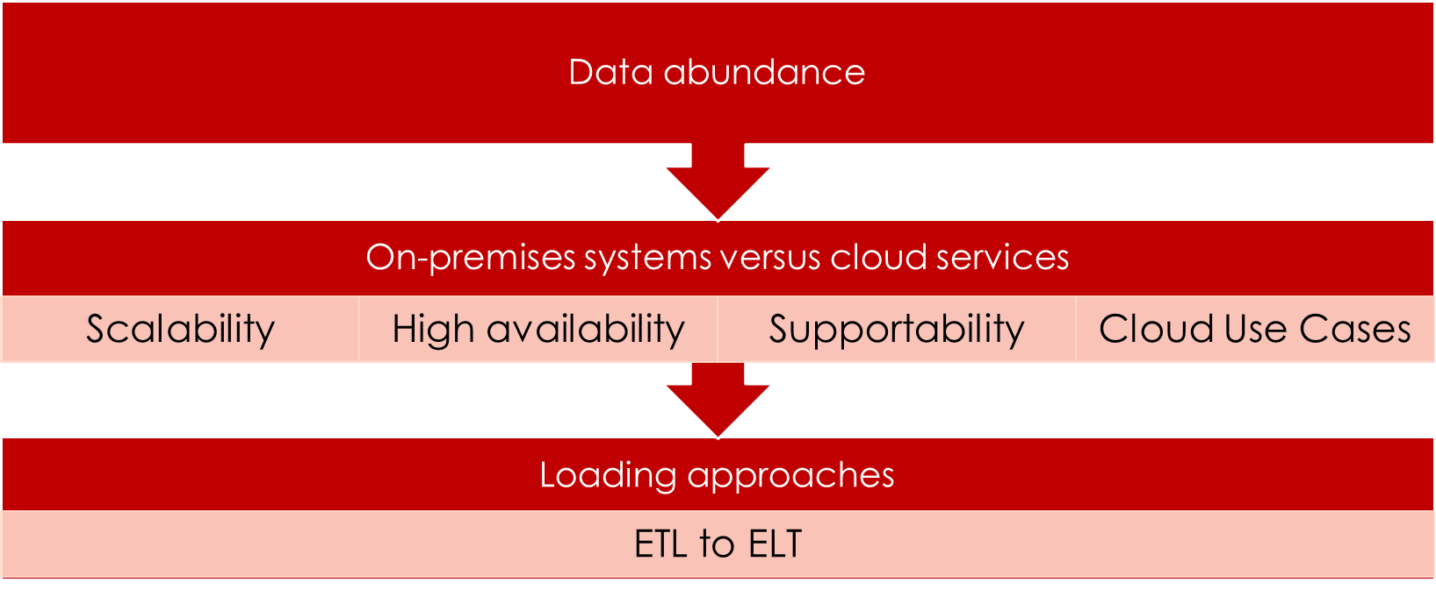
DATA EVOLUTION
Notes:
Before we begin to go into data storage solutions, it is important to understand the evolution of data.
More and more data is being created and ingested on a daily basis. This has grown exponentially lately on a year over year basis. Analysts are reporting that projections for data created in 2020 will be 10 times what was created just a year ago.
This creates issues for on-premises systems in terms of being able to scale and support the increase storage requirements, and how to continue to make this data available to users. This has led to utilization of cloud technologies and services to store this data, and new approaches to how this data is handled and presented.
Use cases for cloud data solutions have become increasingly adopted as the approaches in handling data shift from the traditional Extract, Transform, and Load to a Extract, Load, and Transform approach. We will talk more about this in a moment.

Slide 10
TYPES OF DATA
Structured data
  Tables with Rows and columns
Semi-structured data
  Tags and keys
  No-SQL data
Unstructured data
  No designated structure
  PDF, JPG, JSON, or video files
Notes:
There are three types of data, these are structured, semi-structured, and unstructured.
Structured data is data that has a defined schema that allows it to be easily viewed and sorted. An example of this would be a table or spreadsheet with defined rows and columns.
Semi-structured data may not have a defined schema, but the data does provide certain references within it that may help to categorize and sort the data. Examples would be data that utilizes tags and keys. No-SQL databases are a storage example for semi-structured data use.
The third type is unstructured data. This data has no specific structure to place it within groups of data. Unstructured data is generally made up of videos, pdf documents, and pictures. Though they are unstructured, the do contain markers known as meta data that can be used to logically work with this data.
The emphasis of this course will be primarily around structured and semi-structured data, but is important to understand unstructured data in the data ecosystem.

Slide 11
AZURE DATA STORAGE
Structured versus non-structured data
Azure data sources
  Azure Storage
  Azure Data Lake Storage
  Azure Databricks
  Azure Cosmos DB
  Azure SQL Database
  Azure Synapse Analytics (SQL Data Warehouse)
Additional data platform services (i.e. Azure Stream Analytics)
Notes:
When talking about data and how it is stored, it is important to understand that data can be either structured or non-structured. We will discuss this more on the next slides.
Azure provides many data storage services within their environment for both of these data types. These services include Azure Storage, Azure Cosmos DB, Azure SQL Database, and Azure SQL Data warehouse. Additional platform services are used within the data workflow, such as Azure Databricks, Azure Data Factory, and Azure Stream Analytics.

Slide 12
AZURE STORAGE
General Purpose v2
Containers (BLOBs)
File Shares
Unstructured data
Containers provide a folder structure
Metadata used to identify data
OneDrive
Structured data
File/Folder structure
Azure disk storage
Mapped drives to users
Tables
Queues
Semi-structured data
Unstructured data

Slide 13
SECURITY
Shared Access Signatures
  Anonymous access should NOT be used as a practice
    Exception: Images for website
  Provides secure access to storage data
  Permissions for access
  Expiration
  Ability to quickly revoke if compromised
Replication
  LRS, ZRS, GRS, RA-GRS
Soft delete

Slide 14

DATA LIFE-CYCLE MANAGEMENT
Automated data retention policies
Maintain regulatory, legal, or organizational compliance
Move data from Hot to Cool to Archive to Delete
Best practices or custom policies
Hot
Cool
Archive

Slide 15
DATABASES
Relational Data storage
Non-Relational Data storage
Structured data
Defined schema
Clear relationship between fields and tables
Microsoft SQL
Semi-structured data
No defined schema
Hierarchy is defined by tags and keys
Cosmos DB, no SQL databases
Notes:
There are two main data storage types that we will discuss. These are relational data storage and non-relational data storage.
Relational data storage are those that utilized structured data. As we discussed previously, structured data has a defined schema that can be used to format the data. Relational data storage presents this data in a structured manner because there is a clear relationship between the data fields and tables. An example of a relational data storage service is Microsoft SQL.
Non-relational data storage uses semi-structured data. There is no defined schema and the hierarchy of the data is defined by tags and keys, not fields and tables. Non-relational data storage is often referred to as “No-SQL” storage solutions.

Slide 16

AZURE SQL DATABASE
Azure SQL Database
Managed SQL Instance
SQL Virtual Machine
Fully managed PaaS
Logical SQL servers
Microsoft does all management and patching OS-down, with built-in:
  Upgrades
  Updates
  Patching
  Backups
  Monitoring
99.99% availability
vCore or DTU purchasing models
Other SQL options: SQL Virtual Machine or Managed SQL Instance
Easy lift and shift of databases
Integrated with the benefits of the PaaS solution
99.99% uptime SLA
Built-in high availability
Data protected with automated backups
Customer configurable backup retention period
User-initiated backups
Point-in-time database restore capability
IaaS option
Option when database requires custom settings
Full lift and shift of database applications with minimal reconfiguration
More management overhead
https://docs.microsoft.com/en-us/azure/azure-sql/

Slide 17

COSMOS DB
Globally distributed database service
APIs for SQL, MongoDB, Cassandra, Tables, or Gremlin
Scales throughput and storage at Azure regions worldwide
99.999% availability on read and writes
Multiple consistency levels (understand the pros and cons):
  Strong
  Boundless Staleness
  Session
  Consistent Prefix
  Eventual
https://docs.microsoft.com/en-us/azure/cosmos-db/consistency-levels
https://docs.microsoft.com/en-us/azure/cosmos-db/introduction

Slide 18
AZURE DATA STORAGE
Structured versus non-structured data
Azure data sources
  Azure Storage
  Azure Data Lake Storage
  Azure Databricks
  Azure Cosmos DB
  Azure SQL Database
  Azure Synapse Analytics (SQL Data Warehouse)
Additional data platform services (i.e. Azure Stream Analytics)
Notes:
When talking about data and how it is stored, it is important to understand that data can be either structured or non-structured. We will discuss this more on the next slides.
Azure provides many data storage services within their environment for both of these data types. These services include Azure Storage, Azure Cosmos DB, Azure SQL Database, and Azure SQL Data warehouse. Additional platform services are used within the data workflow, such as Azure Databricks, Azure Data Factory, and Azure Stream Analytics.

Slide 19


CHOOSING AN OPTION
Characteristics
When to use it
Key features
Ingesting data
Querying data
Securing data
Notes:
There are a number of areas to consider when choosing a data storage option.
The top of this slide covers some of the high-level requirements that may be business or technical requirements, such as characteristics, when to use it, and the key features.
The options on the bottom go deeper into the technical requirements that are important to the ETL or ELT workflows and the data engineer of ingesting data, querying data, and securing data
When you begin to architect your own data storage solutions, it is important to review each of these options and which data storage solution fits based on the business and technical requirements.

Slide 20
DEMO
Storage accounts
  Soft-delete
  Shared Access Signatures
  Data Life-cycle Management

Slide 21
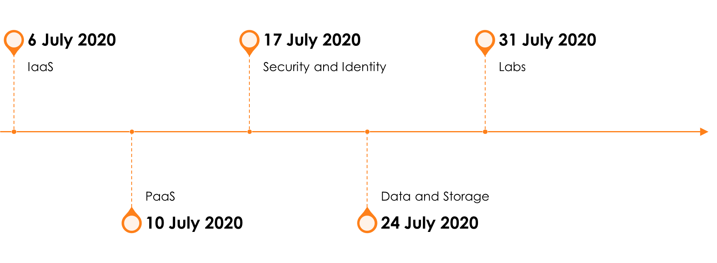
SO YOU WANT TO BE AN AZURE ARCHITECT EXPERT PREP SERIES

Slide 22
Azure Solutions Architect – Data and Storage
Scan this QR-code to access free resources, step-by-step learning guides as well as get practical experience in Azure Architecture – Data and Storage!
https://aka.ms/AA90uvt
Don’t forget to add Microsoft Azure as a skill to your LinkedIn account to stay connected with a developer community!
+ Microsoft Azure
We post the latest announcements about free events for developers in Ireland on our official Twitter account!
@MSDevIRL

Slide 23
THANK YOU!
You can find me on social media at:
https://captainhyperscaler.com
http://linkedin.com/in/dnatwick
@DwayneNcloud
Notes:
Thank you for your time today. Feel free to reach out to me at any of the links on the screen.

